Slide 1

Ortho Eyes
Tim bekema
Beau fiechter
Donna van grunsven
Jasmijn Heupers
Emma korf
Danny vink

Slide 2
Table of contents
What did we do?
Paper progress
Questions

Slide 3
What did we do?
Paper almost finished
Applied test set to the model
Not much in the vacation
Writing the portfolio

Slide 4
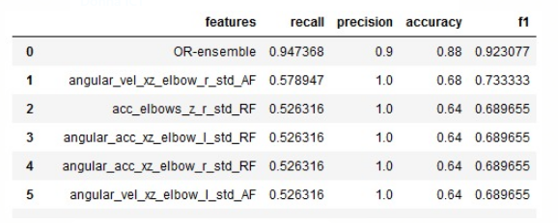
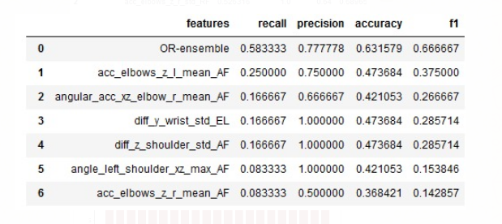
Test set in model
Category 1 vs 2, 3, 4
Cat 2 vs 3,4

Slide 5
What will we do next?
Finish the paper.​
Finishing our portfolios​
Prepare for the exam

Slide 6
Any Questions?

